Slide 1
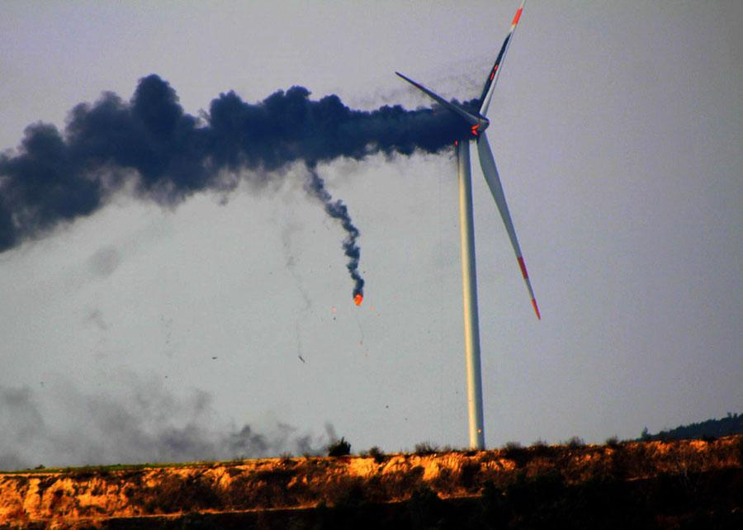


Wind Turbine Failure Analysis
Project No: 140
Name: Praveen Kumar Modalavalasa
Project Role: Data Analyst
Project Guide: Shiv & Shristi Pathak

Slide 2

Project Leadership
Sharat Manikonda
Director at Innodatatics and Sponsor
linkedin.com/in/sharat-chandra

Slide 3
Contents
Business objective
Business Constraints
Project Architecture
Project Overview and Scope
Data collection and details
Exploratory Data Analysis
Visualization
Notes:
Change

Slide 4
Project Architecture
Notes:
Change

Slide 5
Project Overview
Business Problem: Unplanned wind turbine engine failures lead to significant losses and adversely impact electricity generation, causing operational disruptions and financial setbacks.
Business Objective: The primary objective of this project is to minimize unplanned wind turbine failures. By leveraging data analysis and predictive techniques, the aim is to reduce downtime and mitigate financial losses caused by unexpected failures.
Business Constraints: Maximize Power Generation: While minimizing failures, the project must ensure maximum power generation efficiency to meet energy demands and financial targets.

Slide 6
Scope
Develop predictive models using Python for failure prediction.
Create a MySQL database schema for efficient data storage.
Establish connectivity between MySQL and Python.
Connect MySQL database to PowerBI for dynamic reporting.
Provide comprehensive reports and dashboards showcasing failure predictions and trends.
Implement strategies to optimize maintenance schedules based on predictive insights while ensuring maximum power generation.

Slide 7
Data Dictionary
Features | Range | Description
Wind speed (m/s) | 2 m/s (144 km/h, 89 MPH) to 72 m/s (259 km/h, 161 MPH) | The survival speed of commercial wind turbines. Wind speed describes how fast the air is moving past a certain point.
Power (kW) | 2 MW and 3.5 MW. | Power output of wind turbine. Wind power describes the process by which the wind is used to generate mechanical power or electricity.
Nacelle ambient temperature (Â°C) | -20°C to 40°C | level of temperatureon ground. they must withstand a wide range of ambient temperature
Generator bearing temperature | 70 °C to 100°C | temperature of the bearing in generator. Bearing temperature shall not exceed 65°C under 30°C cooling water.
Gear oil temperature | 50 c to 90 c | gearbox oil temperature. Oils operating at high temperature require good viscosity and high resistance to oxidation and foaming.
Ambient temperature | 10°C to 57°C | level of temperatureon ground. Ambient temperature is the air temperature of any object or environment where equipment is stored.
Rotor Speed | 50-300 RPM | Rotational speed of a wind turbine rotor about its axis. Part of the turbine's drivetrain, the low-speed shaft is connected to the rotor and spins between 8–20 rotations per minute.
Nacelle temperature | 30°C to 60°C | temperature of the oil in generator. wind turbine nacelle is that they must withstand a wide range of ambient temperature.
Bearing Temperature | 70 °C to 100°C | The temperature of the bearing in degrees Celsius. Bearings in steam turbines will normally operate at temperatures below 180 degrees Fahrenheit.
Generator Speed | 1000 to 1800 rpm | The rotational speed required by most generators to produce electricity. a speed that allows the turbine's generator to produce AC electricity.
yaw angle | 0 to 60 Degree | The position of the yaw angle degrees. used to turn the wind turbine rotor against the wind.
Wind direction | 0 to 90 Degree | The direction of the wind in degrees.
Wheel hub Temperature | -40 °C to 80°C | The wheel hubs house the bearings that support the main shaft and blades of the wind turbine
Gear box inlet temperature | 40°C to 60°C | The gearbox inlet temperature is the temperature of the air or fluid entering the gearbox.

Slide 8
Exploratory Data Analysis [EDA]
Importing the file in Python(Spyder) or SQL Workbench
Identified the missing values
Performed Four Moments of Business Decision namely:
1. Measures of Central Tendency
Calculated Mean, Median, Mode
2. Measures of Dispersion
Calculated Variance, Standard Deviation, Range
3. Measure of Asymmetry in the Distribution
Applied the code for skewness along with it did the Graphical Representation(histogram) to check for skewness(+ or -).
4. Measure of Peakedness of the Distribution
Applied the code for skewness along with it did the the Graphical Representation(histogram) to check for kurtosis(+ or -).
Did the Univariate Analysis using Bar Plot and Histogram
Did the Bivariate Analysis using scatter plot, identified the correlation coefficient and covariance
Did the Multivariate Analysis using Heat Map
Notes:
EDA is used for seeing what the data can tell us before the modeling task.
Change

Slide 9
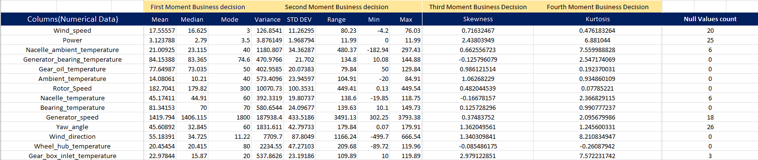
Exploratory Data Analysis [EDA]
Notes:
EDA is used for seeing what the data can tell us before the modeling task.
Change

Slide 10
Data Preprocessing
Identified the null values
Did the Mean Imputation
Identified the duplicate values
Removed the duplicates
Identified the outliers using the Z-score method
Treated the outliers using the Z-Score method
Checked for outliers again using the Z-Score method
Did the Four Moments of Business Decision
Did Univariate, Bivariate, Multivariate Analysis
Calculated Correlation coefficient and Covariance
Notes:
Keep observations

Slide 11
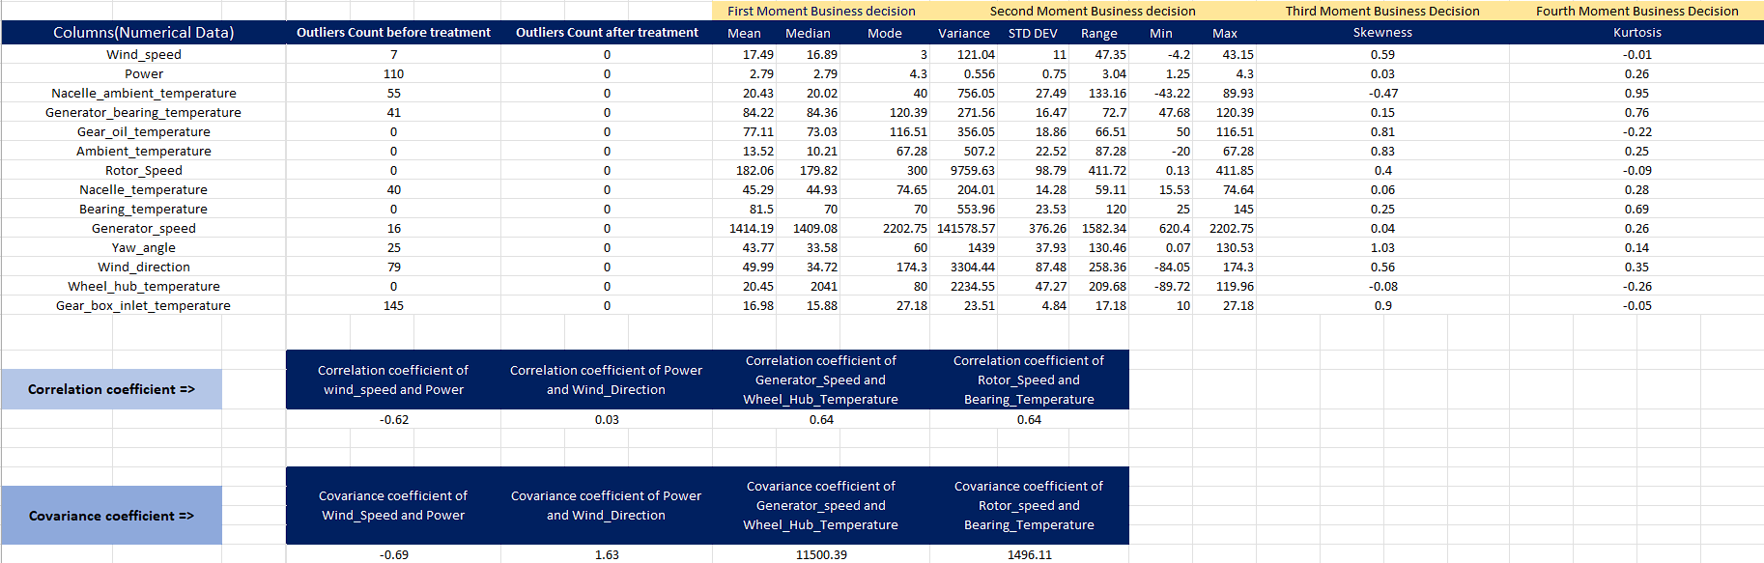
Data Preprocessing
Notes:
Keep observations

Slide 12
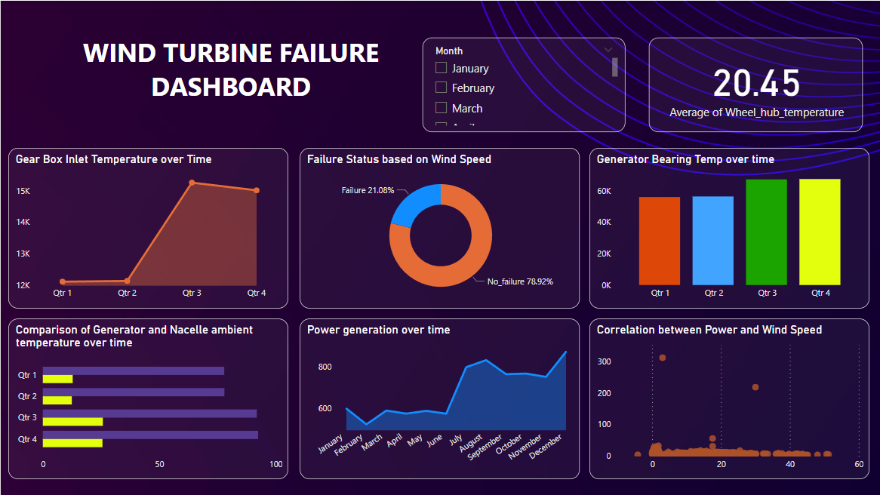
Data Visualization: 01
Notes:
Add graphical

Slide 13
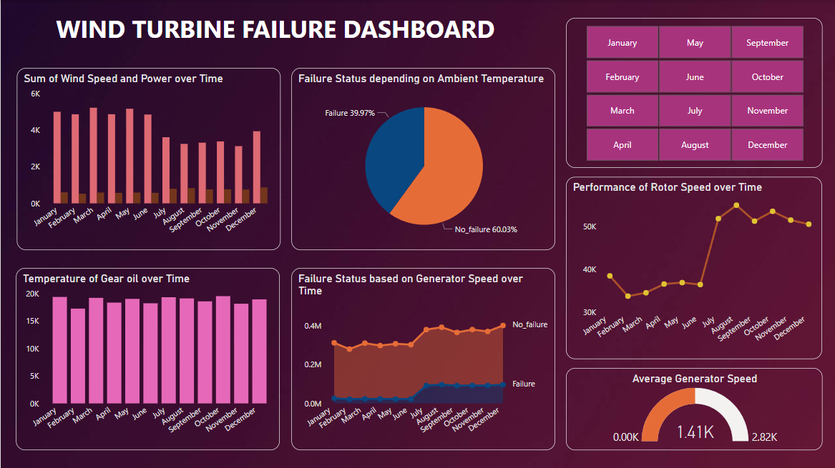
Data Visualization: 02

Slide 14
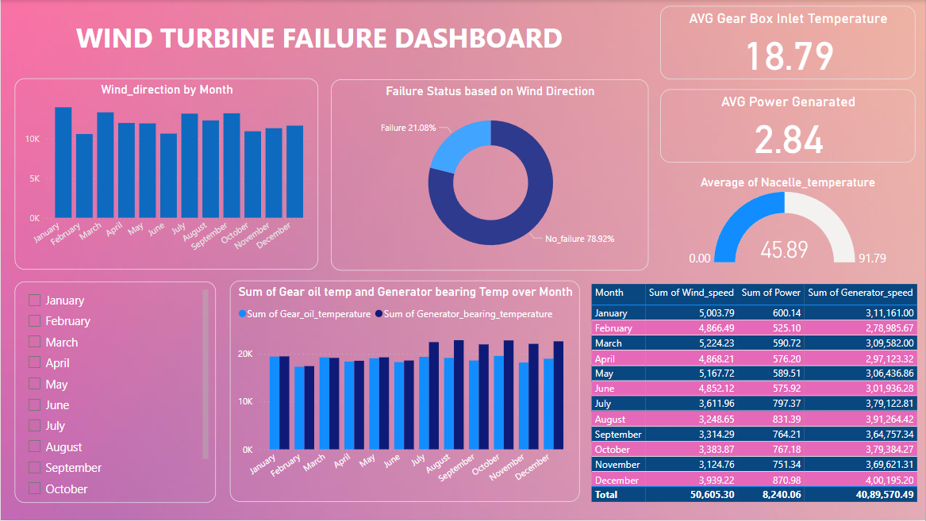
Data Visualization: 03

Slide 15
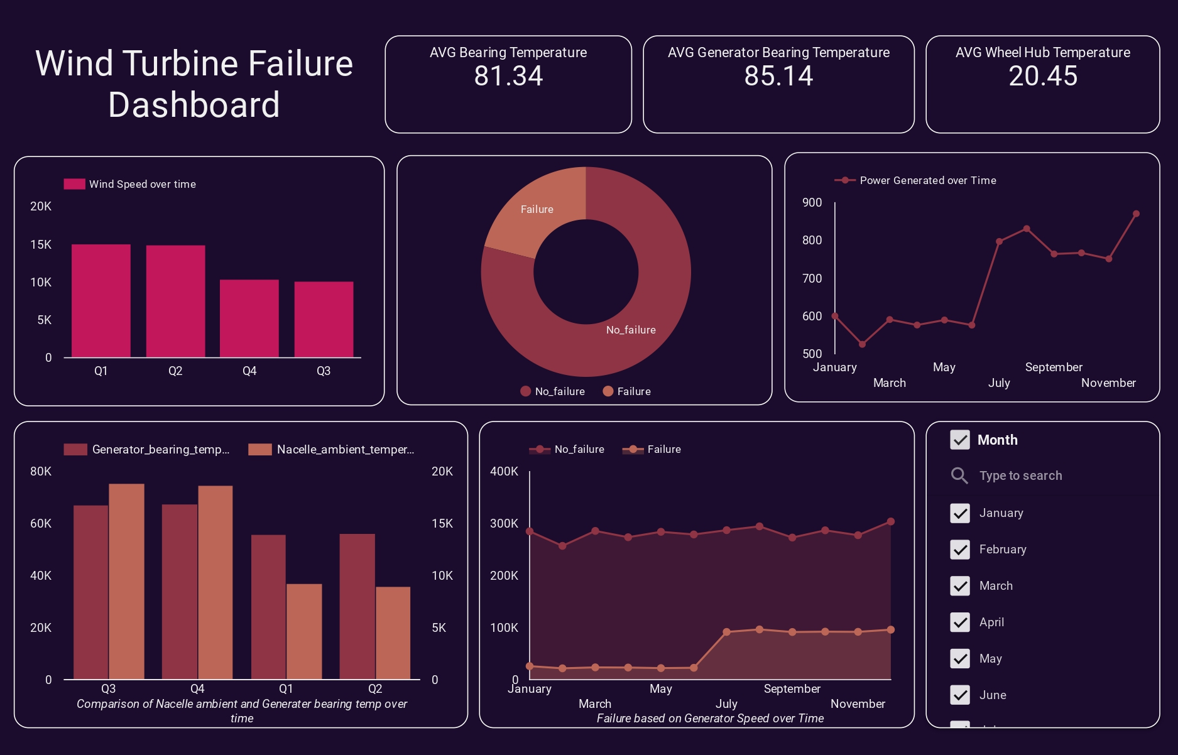
Data Visualization: 03
(Created using Google Looker Studio)

Slide 16


